Slide 1
PORRINHA GAME
By Pedro Caiado

Slide 2
- Challenges
Code overview and terminal application

Slide 3
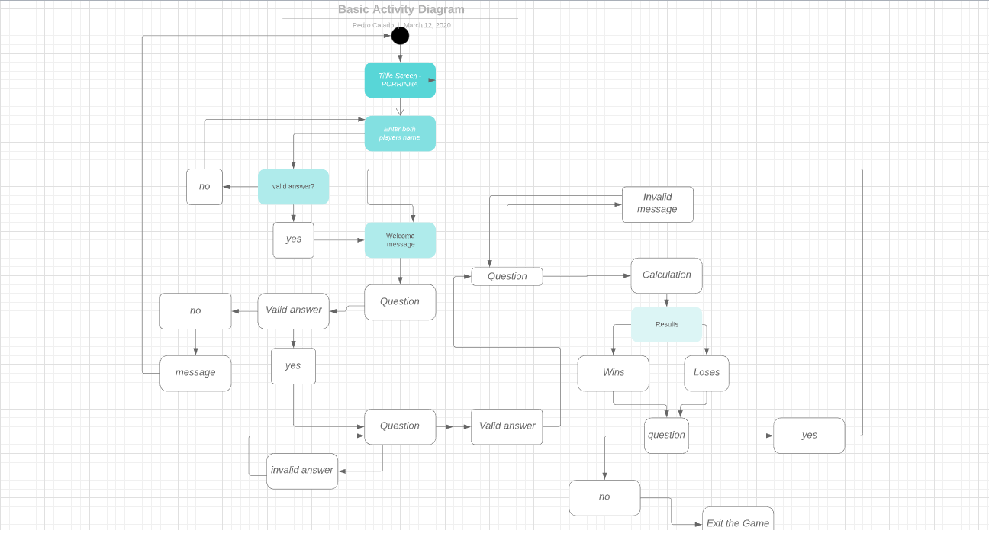

Slide 4
Demo

